Slide 1
Intelligent Health Plan Advisor (IntelliHealth)
Anoushka Bansal
Nishita Vikas Shewale

Slide 2
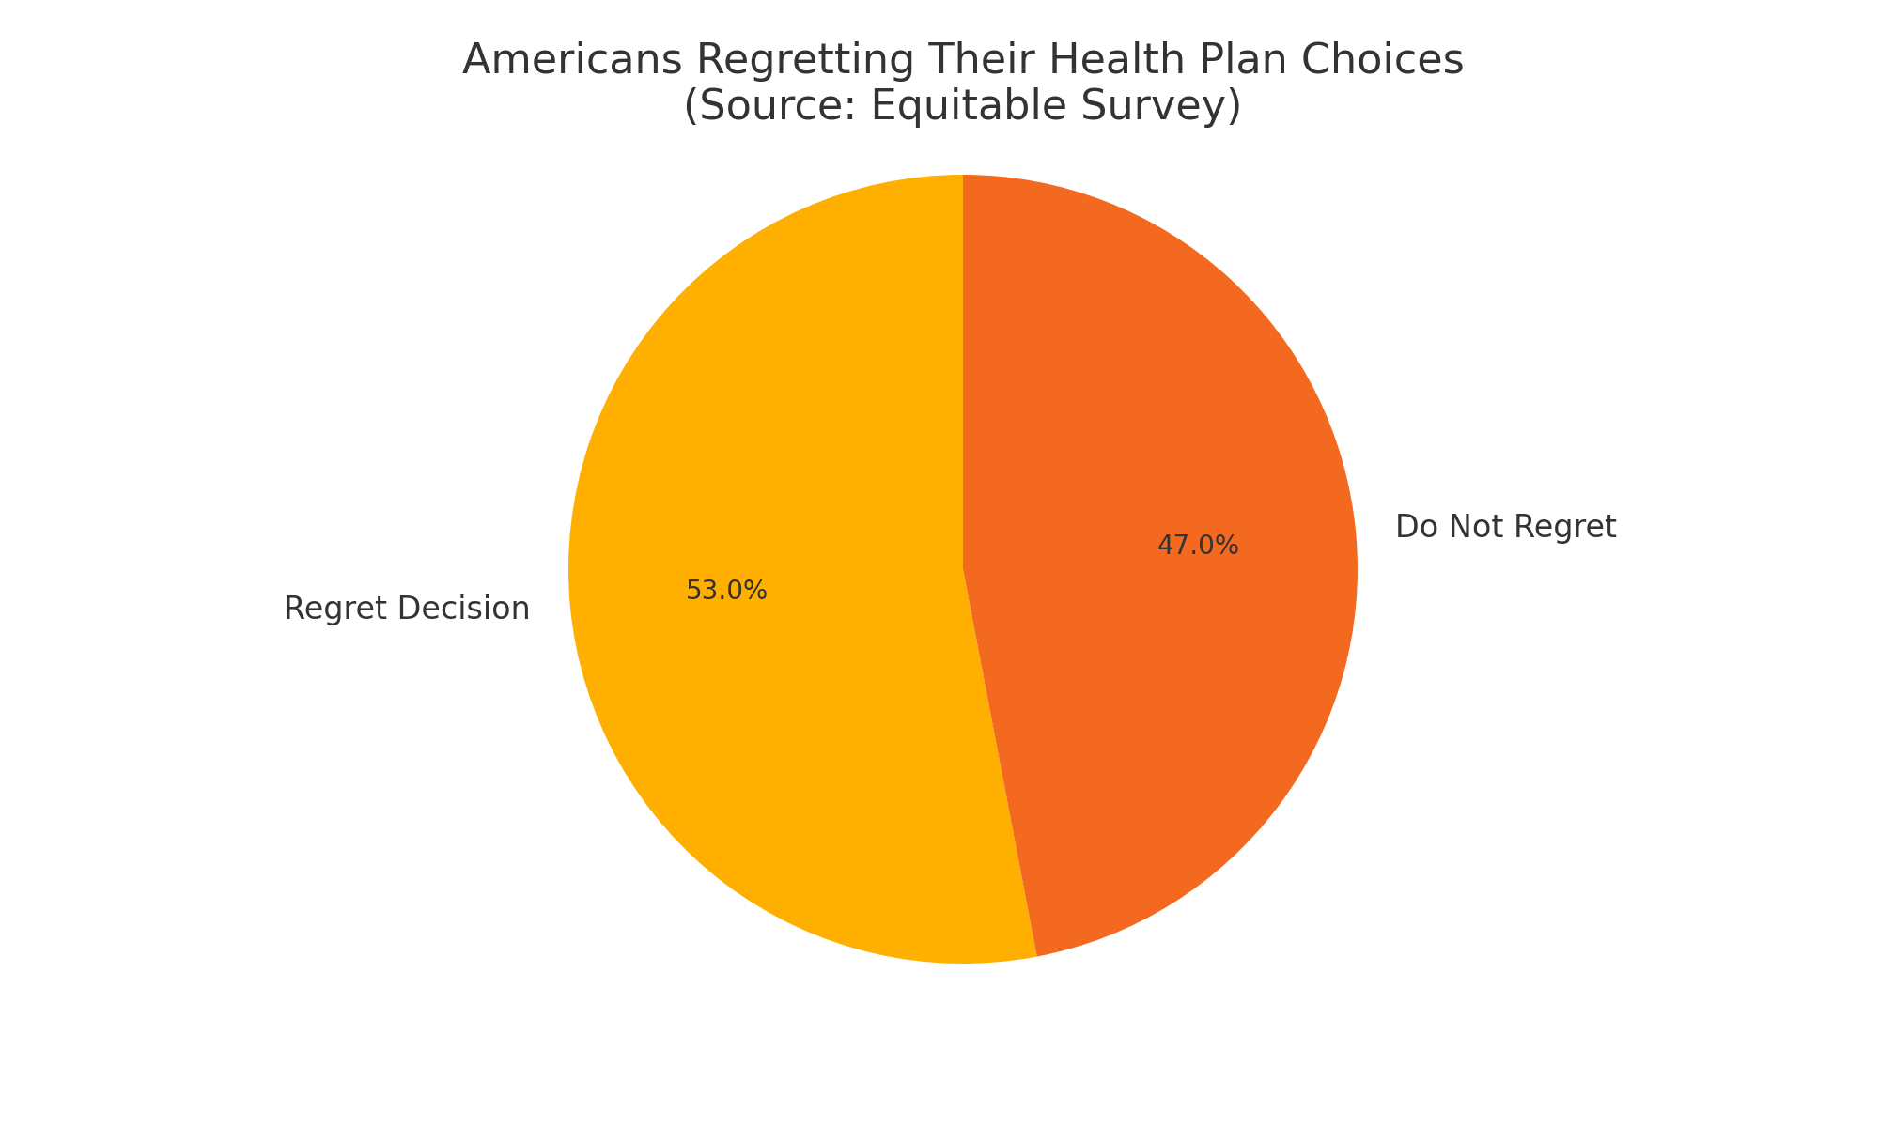
Health Plan Confusion = Costly Mistakes
Many individuals overpay or under-insure due to misunderstanding plan terms: The same Equitable survey indicated that 19% of respondents did not understand the options available or the benefits they selected, leading to suboptimal choices.

Slide 3
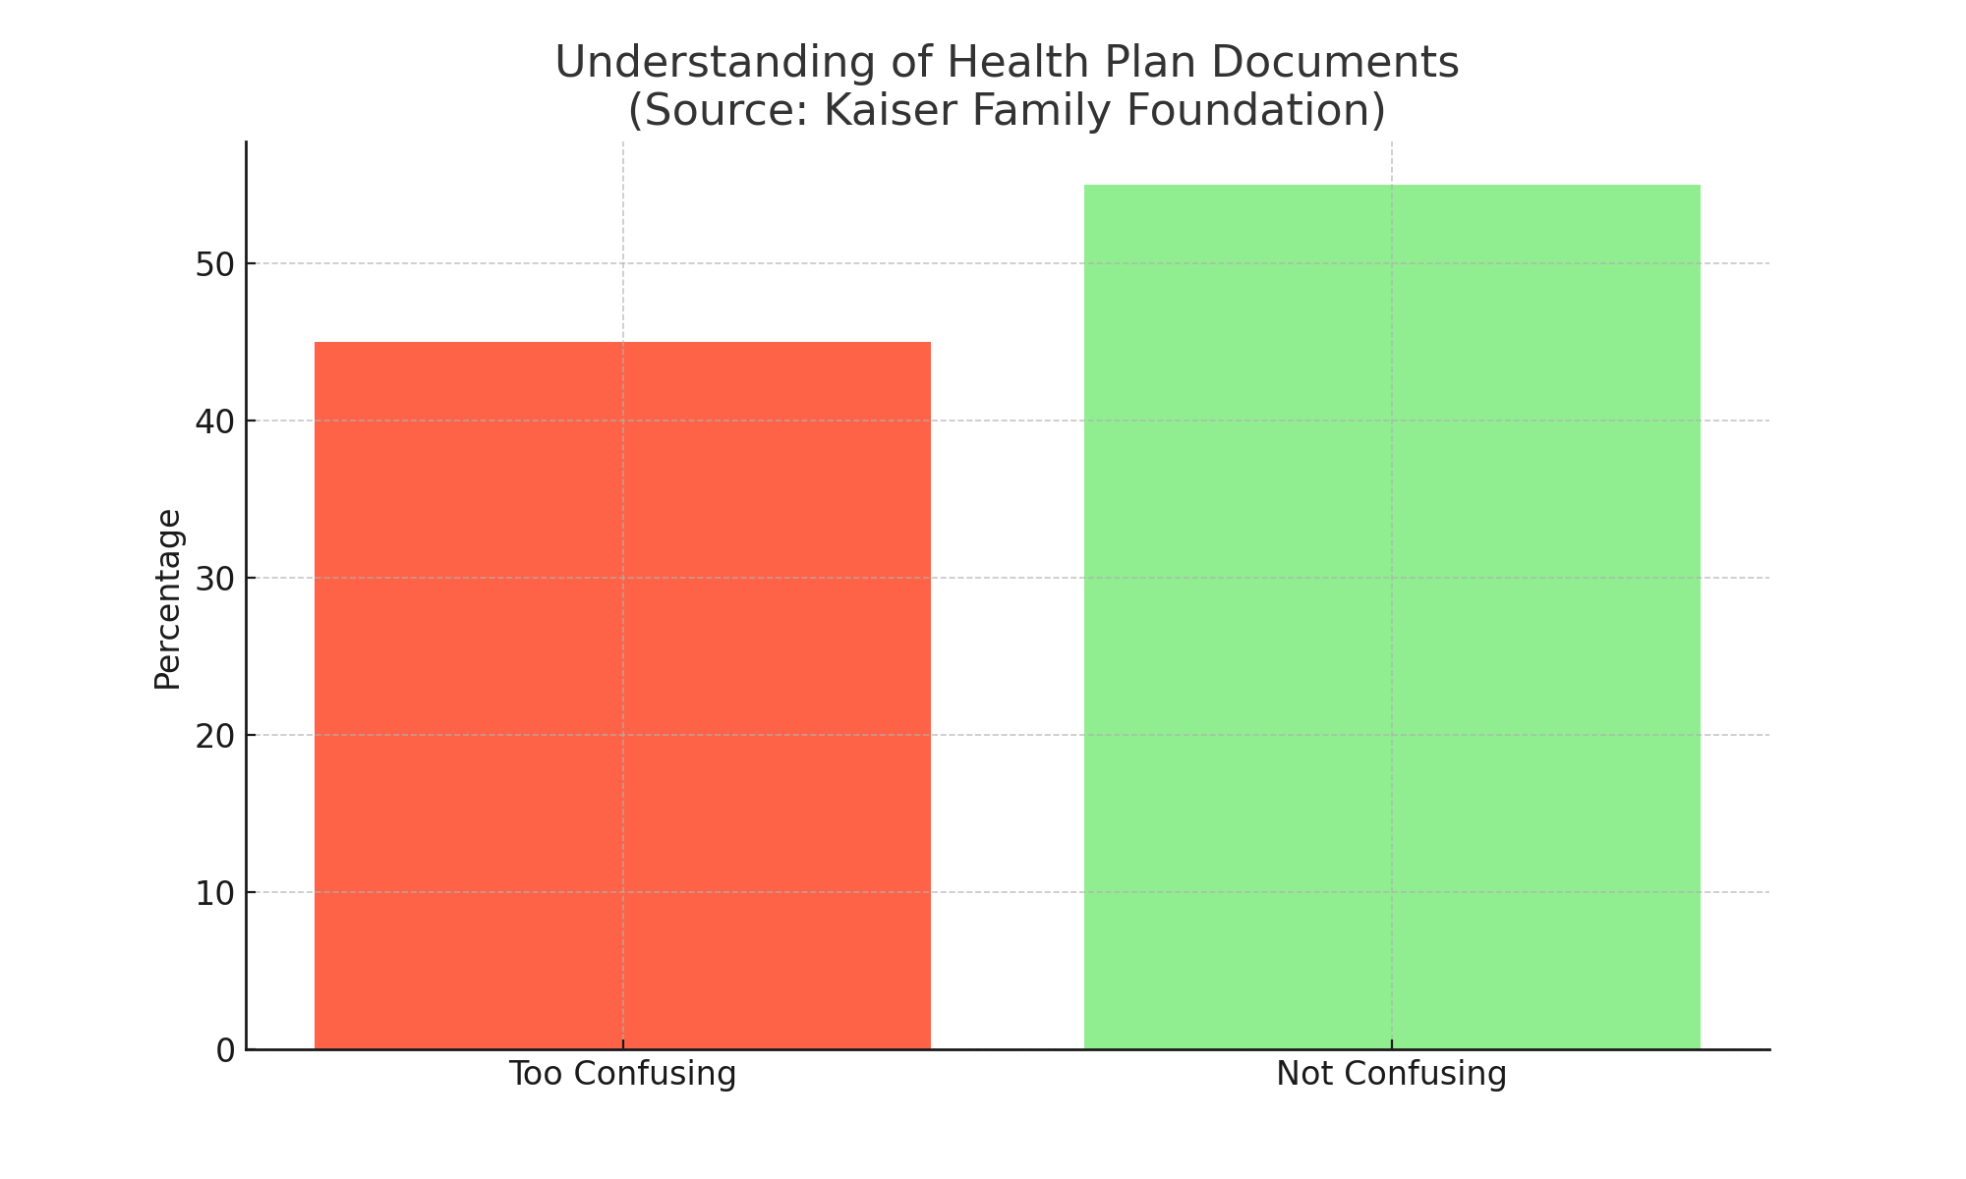
Health Plan Confusion = Costly Mistakes
- 45% of Americans find plan documents too confusing
-A survey revealed that nearly six in ten people with health insurance experienced problems using their insurance in the past year (2023)

Slide 4
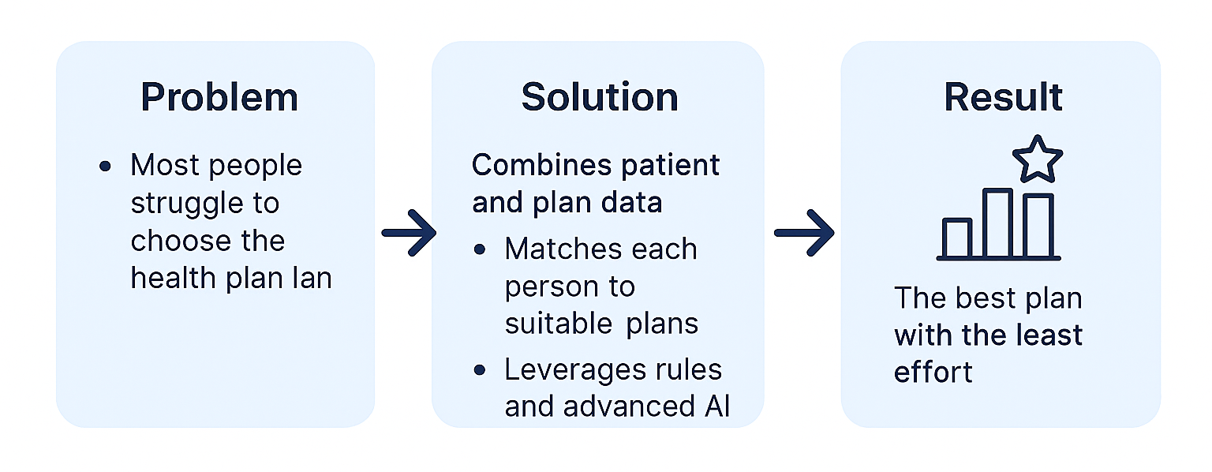
IntelliHealth

Slide 5

Patient demographics
Why store patients in PostgreSQL?
Patient data is small, transactional, and needs CRUD operations
PostgreSQL is fast, structured, and integrates perfectly with FastAPI + SQLAlchemy
Patient Demographics: Each patient profile captures essential demographics and health-related needs — including age, gender, smoking status, activity level, budget, family needs, and chronic conditions — to drive intelligent plan filtering and scoring.
How it works: SQLAlchemy + Pydantic + FastAPI
SQLAlchemy → defines DB tables (Patient)
Pydantic → validates data for FastAPI endpoints
FastAPI → ties validation and DB together via dependency injection

Slide 6
Connecting FastAPI to Snowflake for Insurance Plans
⚙️ How It Works Inside Our System
Patient fills out profile on Streamlit
FastAPI backend connects to Snowflake using a Python connector
A custom SQL query is built based on patient attributes:
State → We only return plans available in the patient’s state
Budget Category (Metal Level) → Filters for Bronze/Silver/Gold/Platinum plans
Travel Coverage → Checks if OutOfCountryCoverage = 'Yes'
Family Coverage → Requires ChildOnlyOffering to contain "Adult"
Has Offspring → Requires ChildOnlyOffering to also contain "Child"
Medical Conditions → Ensures DiseaseManagementProgramsOffered includes the selected conditions
We run this tailored SQL query on Snowflake and receive tuples for eg: [('Plan A', 'HMO', 'Yes', ...), ('Plan B', 'PPO', 'No', ...)]
These are passed into normalize_snowflake_data(), which:
Maps Snowflake column names to Pydantic field names
Converts types (e.g. dates → ISO strings)
Returns a clean list of Pydantic model instances for eg: [InsurancePlan(PlanId='123', PlanMarketingName='Plan A', …), InsurancePlan(PlanId='456', PlanMarketingName='Plan B', ...]
Final result: Structured, validated insurance plans returned via FastAPI as clean JSON

Slide 7
Introducing Neo4j & Why We Use Graphs
🔍 Problem SQL Alone Can’t Solve
SQL can filter relevant plans
But it can’t express complex rule logic like: "If patient has diabetes, prefer plans with low diabetes-specific deductible and copayment"
🧠 Why Neo4j?
Lets us model:
Patients and Plans as nodes
Rules as dynamic relationships
Enables symbolic reasoning through:
(Patient)-[:RULE_NAME]->(Plan) links
Reusable, expressive graph queries
Node Type | Example Fields
Patient | age, gender, conditions, family_coverage
Plan | PlanId, Deductible, Coinsurance, etc.
Relationship | CONSIDERS, DIABETES, OLDER_ADULTS, etc.

Slide 8
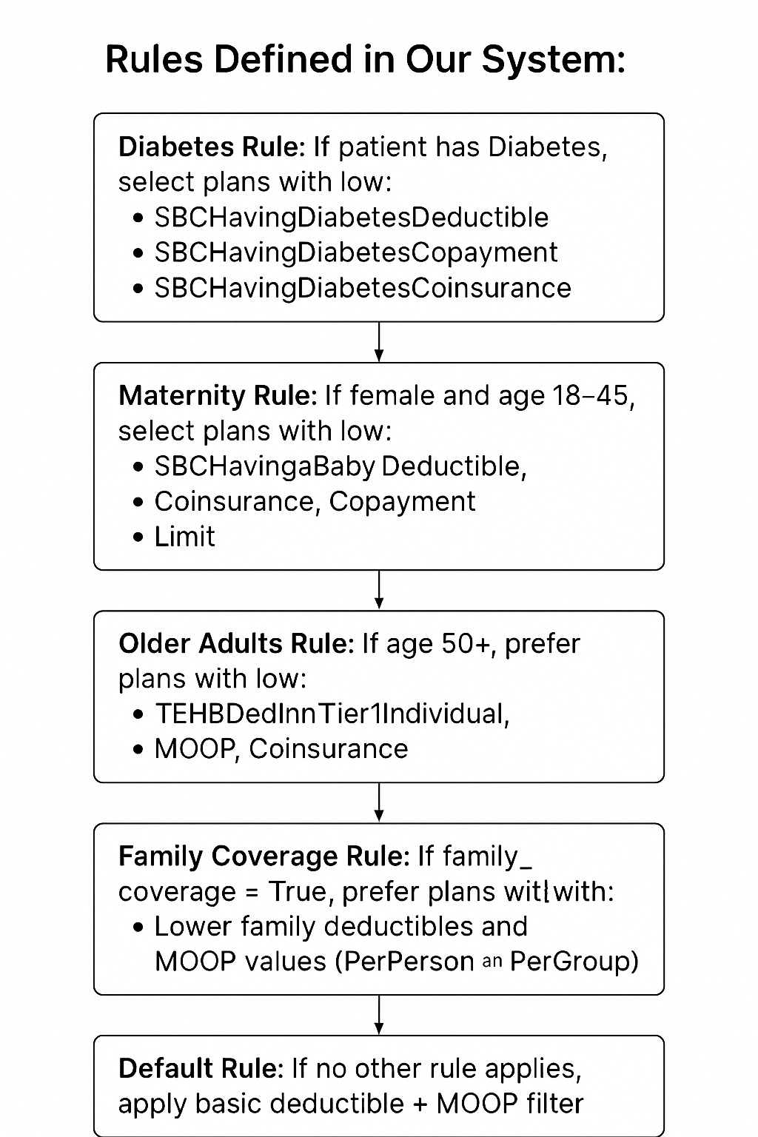
Enhanced Plan Filtering with Summary Statistics
📈 How Our Rule Filtering Works:
Patient qualifies for a rule (e.g., has Diabetes or is within Maternity age)
For that rule, we identify relevant plan attributes (e.g., deductibles, copays)
We group the filtered plans by PlanType (HMO, PPO, etc.)
For each attribute within that plan type:
Calculate the median value
Keep only the plans that meet or beat this threshold (i.e., ≤ median)
We attach a Neo4j relationship between the patient and plans that passed this filtering

Slide 9
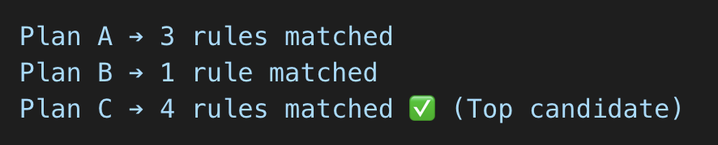
Rule-Based Scoring and Plan Type Distribution
🔢 Counting Rule Matches Per Plan
After applying rules, each plan may match zero or more rules
In Neo4j, we count the number of relationships per plan (excluding CONSIDERS)
🏆 Selecting Top Plans
Plans with the highest rule match count are considered the best fit
These plans move forward to the LLM scoring stage
🌐 Plan Type Distribution
We calculate how many top-scoring plans fall into each PlanType
Example: {
"HMO": 3,
"PPO": 5,
"POS": 2 }
This helps the patient to decide which plan type they want to explore

Slide 10
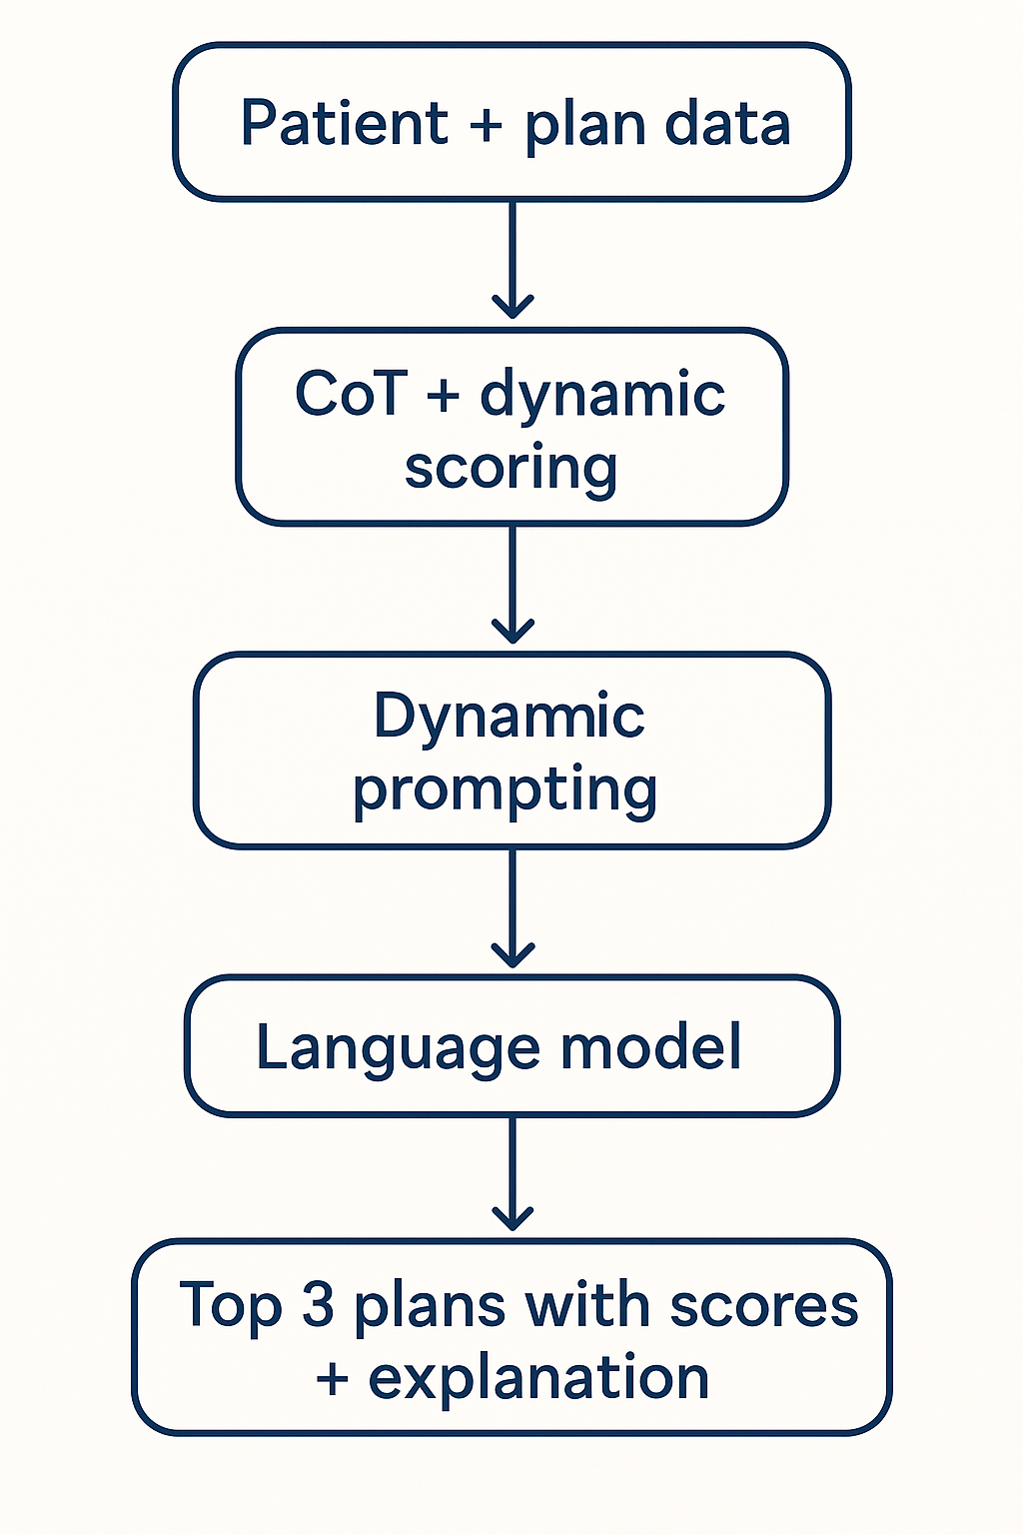
LLM Prompt Design & Dynamic Scoring
🧠 Why LLM Scoring?
Rules help us filter plans that are relevant, but we want to evaluate how well each plan aligns with the patient’s unique profile
We use LLMs to dynamically score and rank plans by simulating expert reasoning
📋 What Our Prompt Includes:
A complete patient profile (age, gender, conditions, lifestyle, etc.)
A filtered set of top plans (from Neo4j)
Instructions for the model to evaluate each plan attribute-by-attribute
A scoring system based on relevance level (high/moderate/low/none) with points
Explicit requirement to explain why each score was given → Chain-of-Thought (CoT)

Slide 11
LLM Prompt Design & Dynamic Scoring
🧪 Example of Chain-of-Thought in Scoring:
"The patient is young and cost-conscious — this HSA-eligible plan fits their financial strategy → +3 points"
"The patient works in a physical job (e.g. construction), so coverage for fractures is highly relevant → +2 points”
💡 Dynamic Scoring: Pros & Cons
Pros:
Highly personalized: Adapts to unique patient context using CoT-style reasoning
Scalable & model-friendly: Attribute names can vary, and the model still understands intent
No need for rigid schemas: Unlike Neo4j or SQL-based scoring, we don't hardcode categories or weights
Easier evolution: Adding a new attribute or changing language doesn’t break logic
Cons:
No predefined answer: There's no single “correct” score; outcomes can vary between runs
Non-deterministic: Same input may yield slightly different output depending on token randomness
Harder to validate: Since output is model-generated, debugging a bad recommendation is less transparent

Slide 12
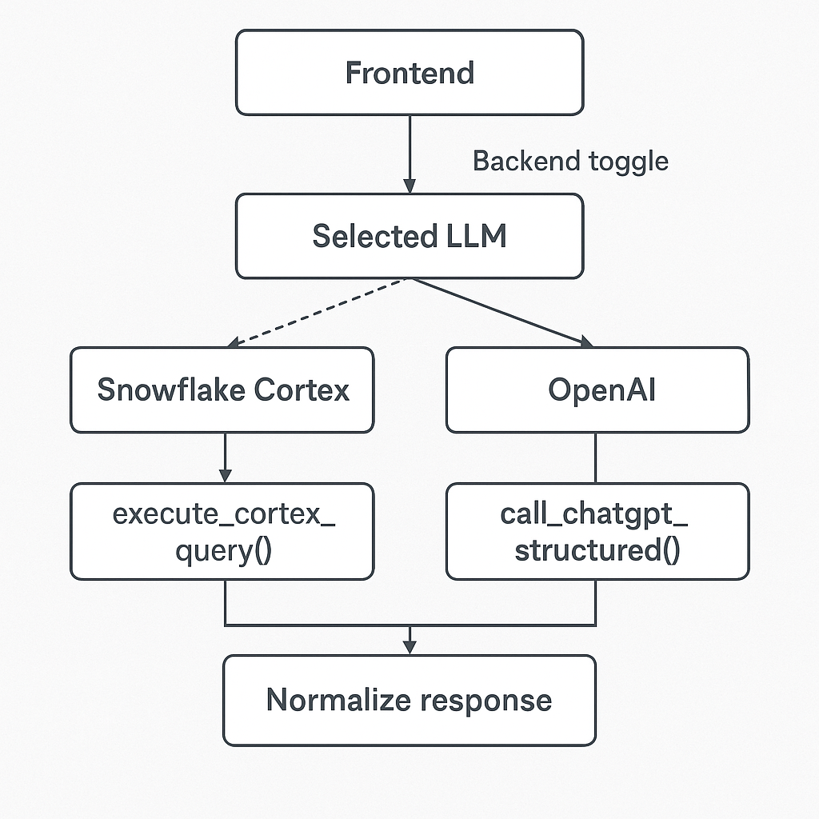
Technology & Integration Challenges

Slide 13
Project Demo

Slide 14
Thank You !

